Slide 1
Planning and Scheduling of Construction of Nursing home
Course Project:- Estimation and Construction Management
By
Gaurav Singh

Slide 2
Introduction
Project mangemenet:- Way of managing various components in such a way that the project is completed within the deadline.
Stages in Project Management-
Planning
Scheduling
Controlling and Monitoring

Slide 3
Overview
• Creation of Work Breakdown Structure
• Assignment of the activities and duration to WBS
• Deciding relationships and order of activities
• Allocation of roles and resources to activities
• Scheduling the project
• Creation of baseline of the project
• Earned value analysis of the project based on the updates
• Rescheduling the project

Slide 4
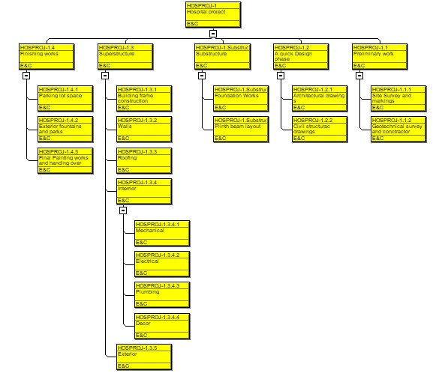
Work Breakdown Structure

Slide 5
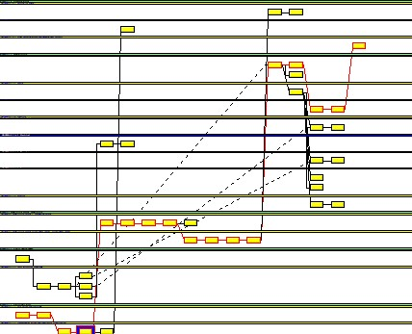
Activities Relations and Durations

Slide 6
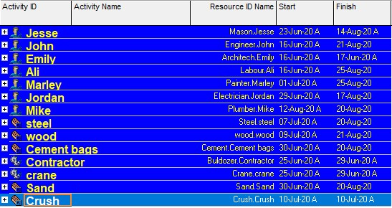
Resources Assigning and Baseline Schedule

Slide 7
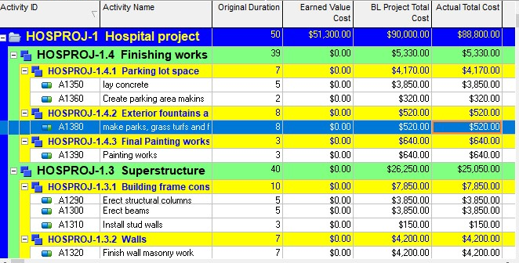
Update1

Slide 8
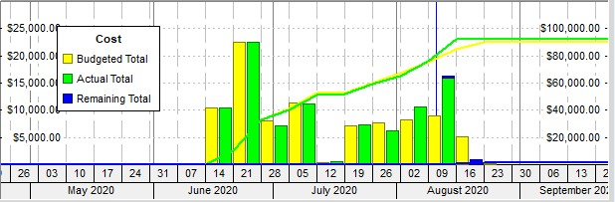
Cash Flow Diagram

Slide 9
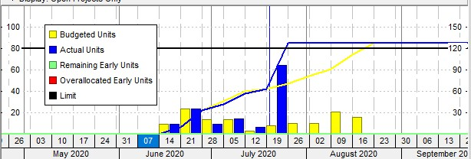
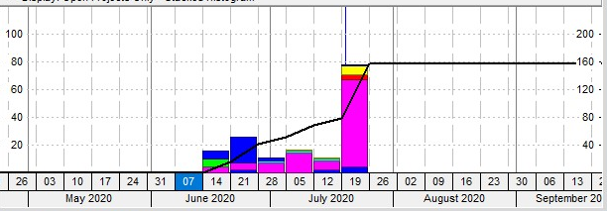
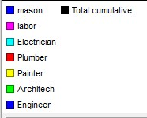
Resource Histogram

Slide 10
Earned Value Analysis
For first update
1 Earned Value = $51,300
2 Actual Value = $88,880
This means 51,300 dollars work is completed out of $88,880

Slide 11
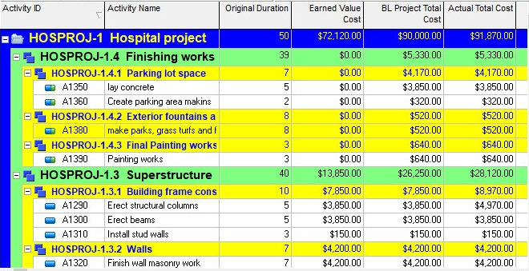
Update 2
Second update date = 12 August 2020

Slide 12
Assumed delays and suspension
In update 2, base columns erection got delayed by 2 days
and used 56 cement bags instead of 40 bags as planned this increased the total cost of project by $3,000
and also
activity truss laying was supposed to finish on 12th but on 12th only 80% work is done
and used 2 tonnes of steel instead of 1 tonne as planned

Slide 13
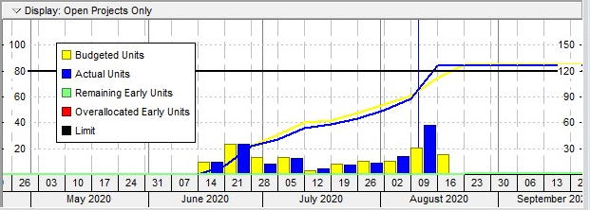
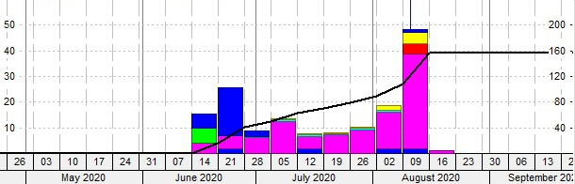
Resource histogram for second update

Slide 14
Cash Flow Diagram for second update

Slide 15
Rescheduling
Activity ID Field Old Value New value
----------- ----- --------- ---------
A1180 Remaining Duration 2 1
(plint beam curing)
A1340 Remaining Duration 4 3
(roof sheet installation)
A1390 Remaining Duration 2 1
Reducing duration to 47 days from 50days

Slide 16
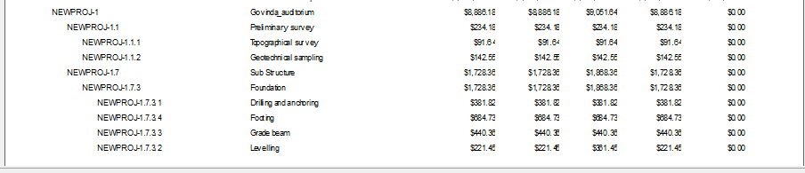
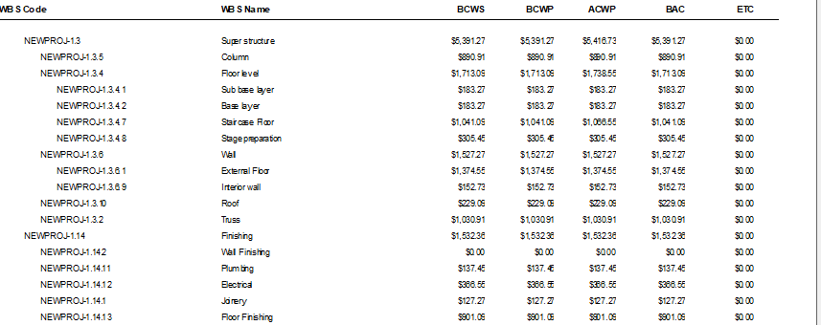
Result

Slide 17
Thank You

